Slide 1

UNIVERSITY INSTITUTE OF ENGINEERING
COMPUTER SCIENCE ENGINEERING
Bachelor of Engineering (Computer Science & Engineering)
Subject Name: Big Data Analytics
Subject Code: 20CST-471
Introduction to Map Reduce paradigm.
Mapped with CO3
Prepared By:
Er. Ankita Sharma
DISCOVER . LEARN . EMPOWER

Slide 2
Apache Spark and its features, Introduction to Apache Flink.
Apache Spark is a powerful, open-source, distributed computing system that provides an advanced analytics engine for large-scale data processing. It is designed for speed, ease of use, and versatility, offering a unified platform for batch processing, interactive queries, streaming analytics, and machine learning

Slide 3
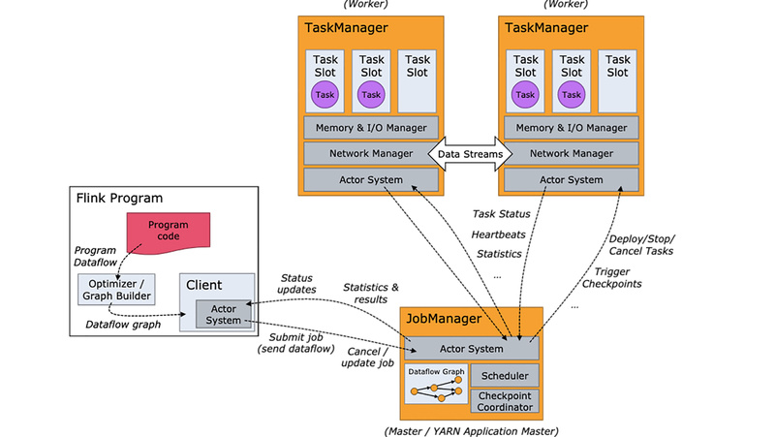

Slide 4
Some key features of Apache Spark include:
Speed:
Spark achieves high-speed data processing through in-memory computation, reducing the need for data to be stored on disk between tasks. This makes it well-suited for iterative algorithms and interactive data analysis.
Ease of Use:
Spark provides high-level APIs in languages like Scala, Java, Python, and R, making it accessible to a broad audience. It also includes built-in libraries for machine learning (MLlib), graph processing (GraphX), and SQL-based queries (Spark SQL).
Versatility:
Spark supports various data processing workloads, including batch processing through its core engine, interactive queries with Spark SQL, machine learning with MLlib, and graph processing with GraphX. Additionally, it offers a structured streaming API for real-time data processing.
Fault Tolerance:
Spark achieves fault tolerance through resilient distributed datasets (RDDs), a fundamental data structure in Spark. RDDs automatically recover lost data partitions on node failures, ensuring the reliability of distributed computations.

Slide 5
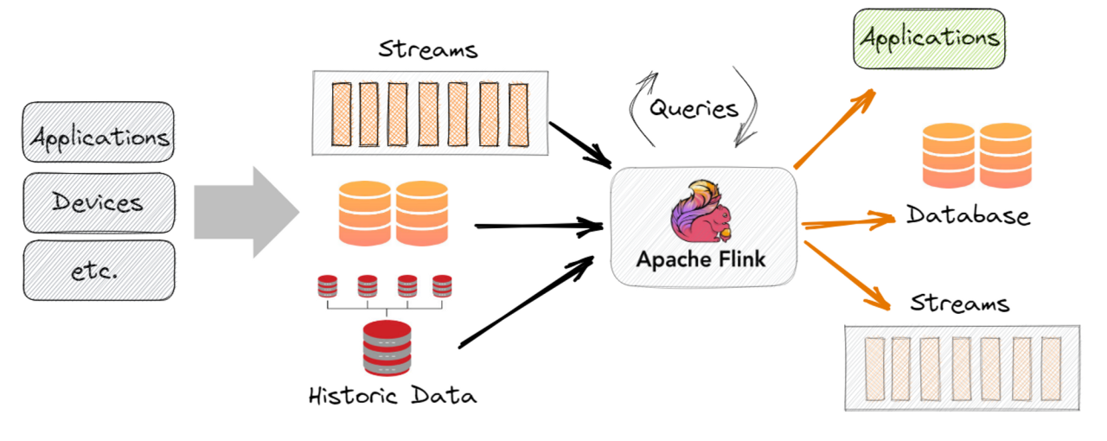

Slide 6
Introduction to Apache Flink:
Apache Flink, is another open-source, distributed stream and batch processing framework designed for big data analytics. Flink is known for its low-latency, high-throughput, and exactly-once processing semantics. Some key aspects of Apache

Slide 7
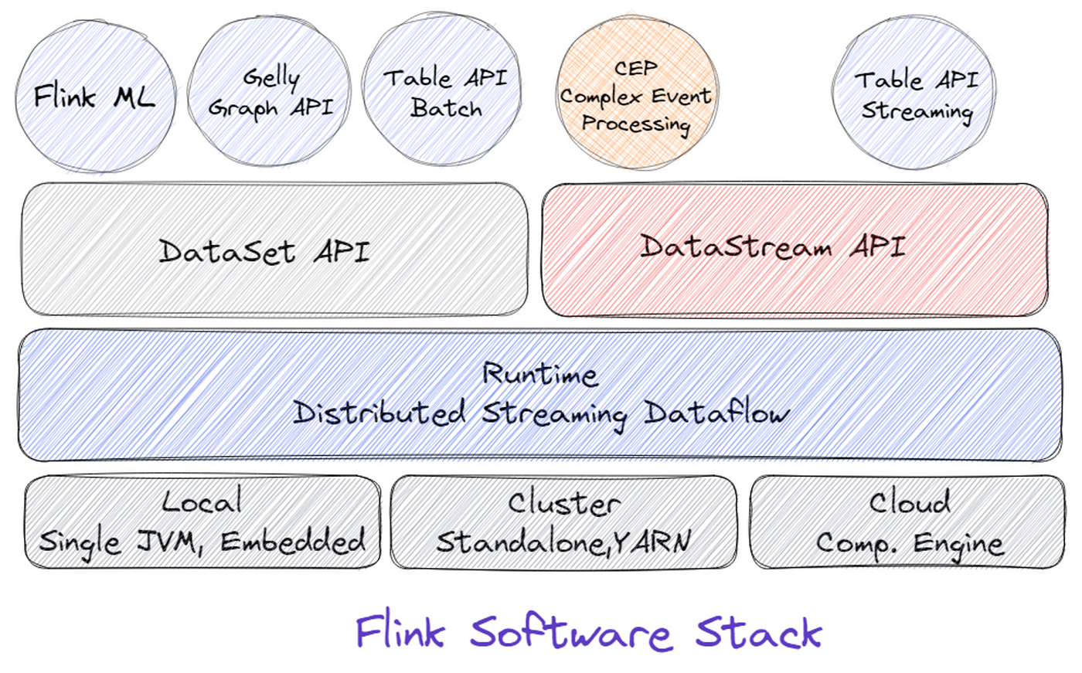

Slide 8
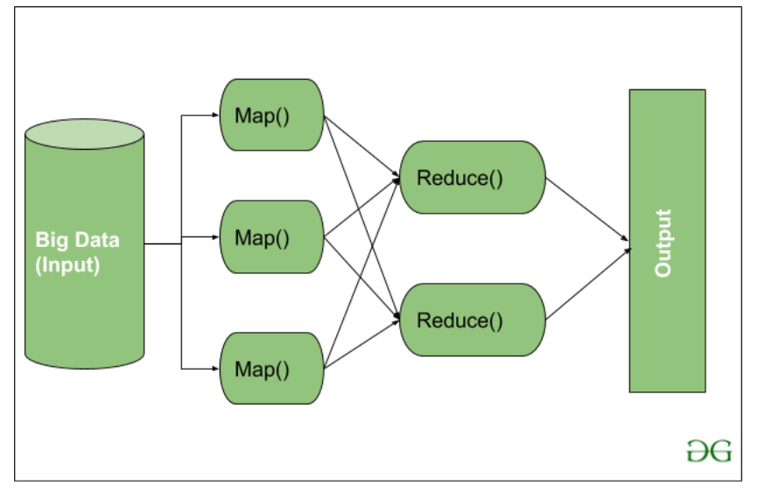

Slide 9
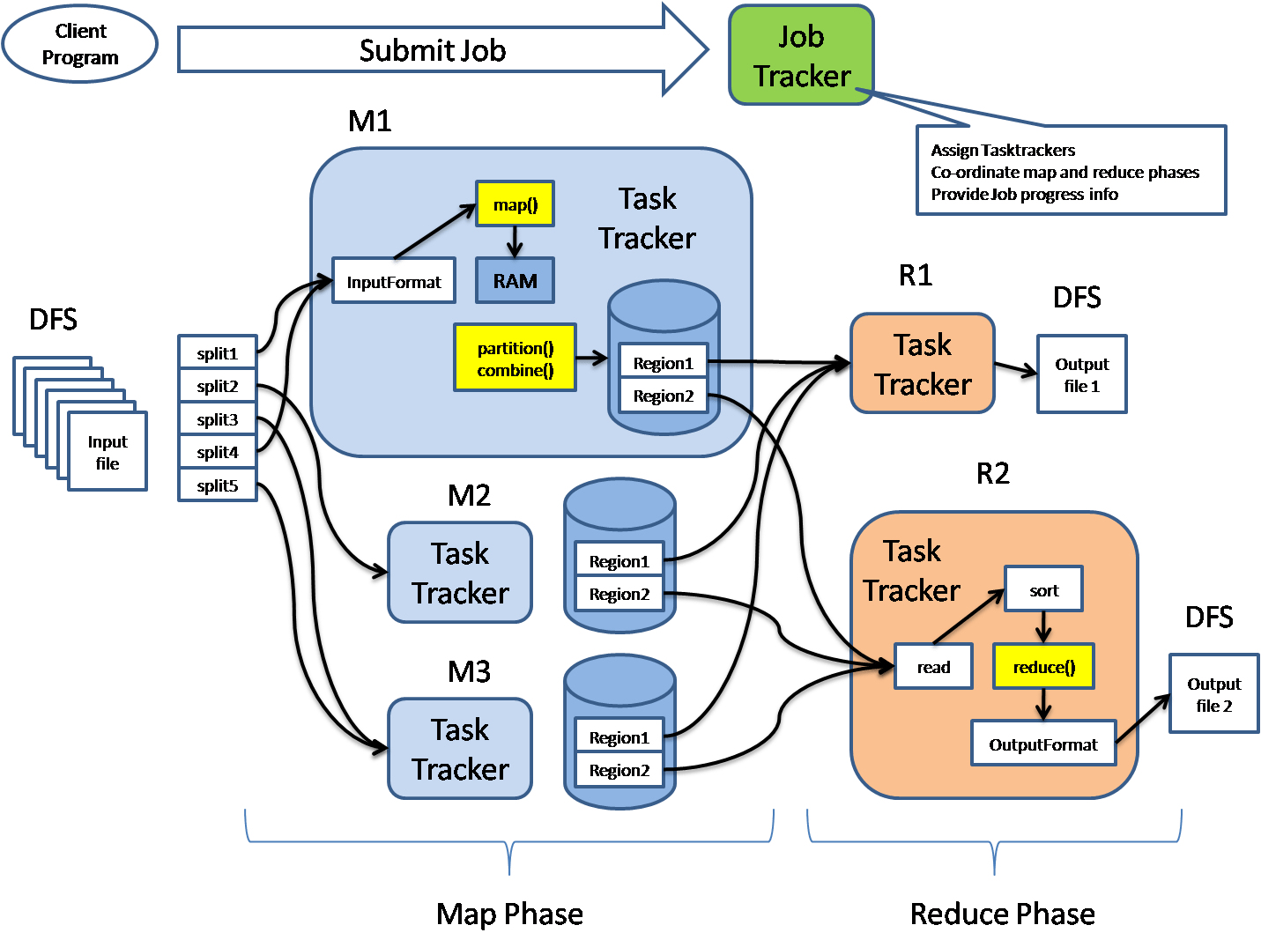

Slide 10
Thankyou

